Slide 1
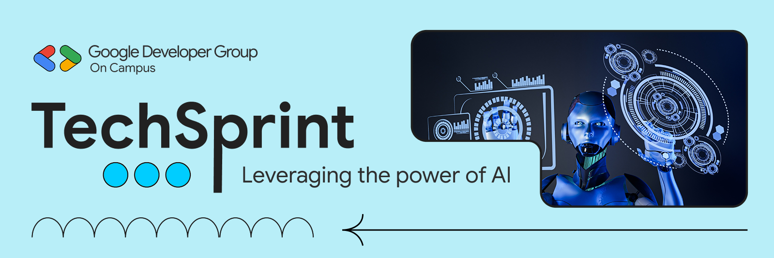
Team Details:
a.Team Name:
HackTrix
b.Team Leader Name:
Naithan Kant Jena
c.Problem Statement:
“Programming often feels challenging and uninteresting for beginners due to abstract learning methods. An open-world puzzle-based approach can make learning coding engaging, interactive, and fun.”

Slide 2




Problem Statement:
Learning programming is often boring, confusing, and overwhelming for beginners.
Most existing platforms are text-based and lack real-world interaction, which results in:
There is a strong need for a fun, interactive, and immersive learning experience that makes programming easier and more engaging.
Proposed Solution:
We introduce a game-based learning platform designed to make coding simple, engaging, and enjoyable.
The platform helps users learn programming concepts
through interactive gameplay, encouraging learning by
practice rather than memorization.
-Low engagement and motivation.
-Difficulty in choosing the right programming language.
How It Helps:
-Poor practical exposure.
-High dropout rates among learners.
•Makes learning coding more engaging.
•Reduces fear and confusion around programming.
•Encourages logical thinking.
•Improves interest and confidence in beginners.

Slide 3

a. How different is it from any of the other existing ideas?
This concept makes coding simple, engaging, and fun by combining creativity with learning, removing the fear and complexity students often face.
As an open-world coder-building game, it turns gameplay into an interactive learning experience where users naturally develop coding skills.
“It’s Creativity can and will attract the User and he/she will understand the concept.”
b. How will it be able to solve the problem?
The game solves the learning problem by teaching multiple programming languages in a playful, interactive way that helps users easily understand coding concepts.
A level-based system guides learners from basic concepts to advanced topics like OOPS, increasing difficulty as skills grow.
“Learning through levels turns complex coding concepts into achievable milestones.”

Slide 4

List Of Features Offered
By The Solution
🎮 CORE GAMEPLAY FEATURES
🆘 LEARNING SUPPORT & LIFELINE
Open-World Interactive EnvironmeNt.
Multiple Programming Language Paths.
Level-Based Coding Challenges.
Real-Time Feedback System.
Game has a computer in which game will work
It Has Four Lifeline so that the user can try 4 four times and if cannot He/She can restart the game after 5 mins
“A game-based platform combining coding,gamification,and learner support.”

Slide 5
GOOGLE TECHNOLOGIES
Used In The Solution:
Gemini AI (Google
Gemini was used as an AI assistant during the game development process:
🧠 Game Logic Support – Helped understand and improve coding logic.
🛠 Bug Fixing Assistance – Helped identify errors and suggest fixes.
📜 Code Assistance – Supported in writing and optimizing game scripts.

Slide 6
Due to the limited time available, we are developing a demo version of the concept with a small game terrain and a limited number of programming languages.
This demo is intended to validate the idea and demonstrate how coding can be learned in a fun and engaging way.
If the concept proves successful, we plan to expand it into a full-scale game with a larger environment, support for multiple programming languages, and the integration of Data Structures and Algorithms (DSA).
This will help students learn both coding and DSA concepts in an easy and interactive manner.
Additional Details/
Future Development

Slide 7
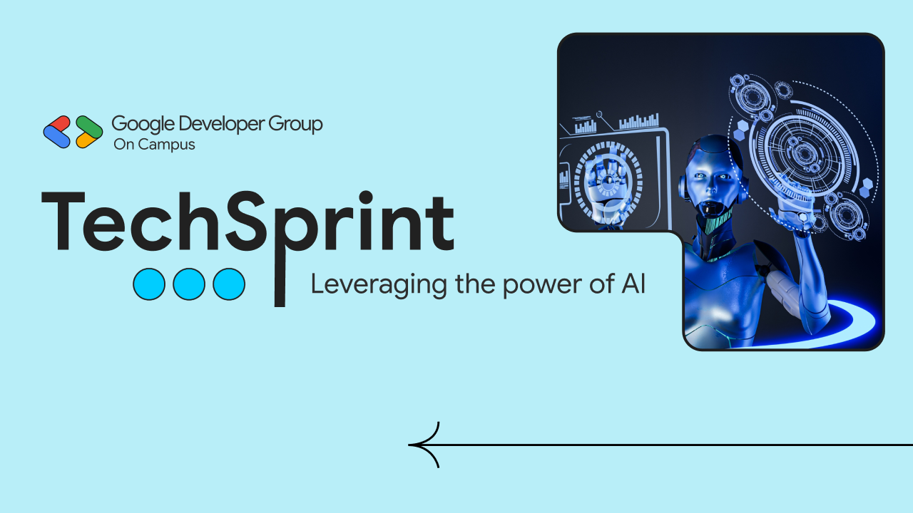
Thank you!

